Slide 1


Healthcare
Stroke Data
By- Group 6
SRI SRAVYA TAMMINEEDI,
KEYUR RASHMIKANT SHAH

Slide 2
INTRODUCTION
Dataset - based on healthcare which involves several attributes like age, gender, heart disease, smoking status, hypertension, work type, bmi level of a patient which is taken from Kaggle ^{[1]}
Aimed to create a model that can predict what kind of patients are more prone to get a stroke in order to help medical industry in improving heart treatments.
Performed exploratory data analysis.
Compared 2 models - Logistic regression and Random Forest

Slide 3
Step 1: Data Cleaning
Data set has 12 columns and 43, 400 rows.
Bmi (Body Mass Index) has 1,462 NA (~3%), Hence mean of the bmi was used to replace the NA values.
Smoking status has 30% NA values which are replaced with a relationship between work type and smoking status.
90% of the children did not mention their smoking status and out of the children who mentioned their smoking status - never smoked.
So, for better analysis, we filled the smoking status of the children who did not mention their smoking status to never smoked.

Slide 4
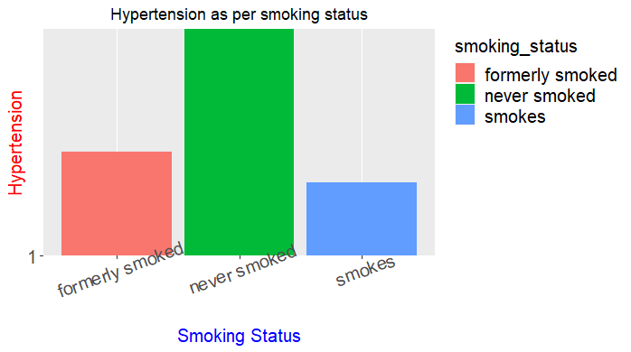
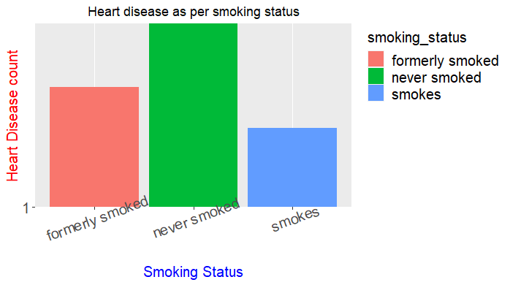
Step 2: EDA
The bar plot shows the comparison of hypertension as per the smoking status of people.
Hypertension of patients who never smoked is highest and patients who smoke is lowest.
Patients who never smoke have higher chances of heart diseases count and those who smoke have less chance of heart diseases.
This is because, patients who never smoked, assumes that only people who smokes will get effected and will not be careful but they started showing some symptoms of heart diseases slowly.

Slide 5
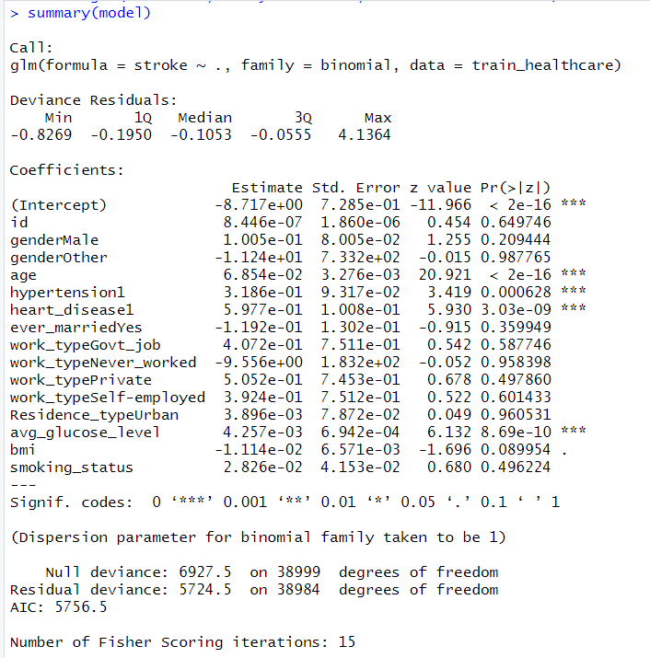
Model 1: Logistic Regression
We have a binary classification in the outcome [patient suffers stroke or not] hence we used Logistic regression.
Factors that significantly affect stroke are age, hypertension,heart disease, and glucose level and also it can been seen through higher z score value.

Slide 6
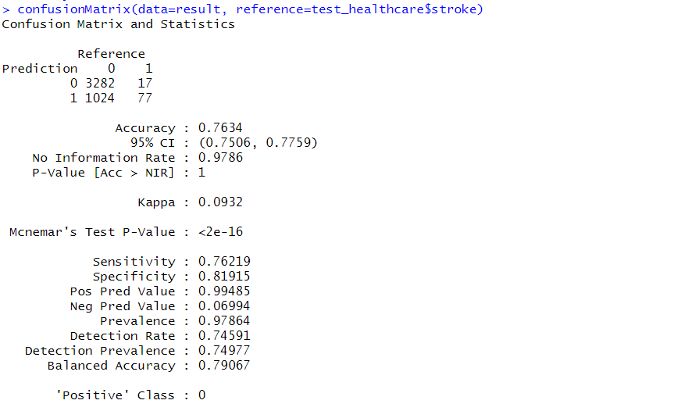
Logistic Regression(Continue)
Confusion Matrix allowed us to compare the correct and incorrect number of predictions made by our logistic model.
This classification algorithm gave an accuracy of 76.34% with 95% confidence interval.

Slide 7
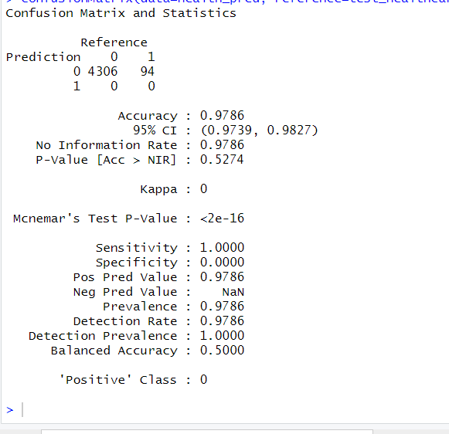
Model 2: Random Forest
Split data into training and testing dataset, 80% and 20% respectively.
Train models using Logistic Regression.
TP :4306 ,Accuracy is 98%.
FP :94 ,Error-2%

Slide 8
Conclusion
Age, hypertension, heart disease, and glucose level are highly statistically significant factors which affect the probability of stroke in patients.
Logistic Regression gave us the important factors for the analysis to predict the problem.
Random forest leads to more accurate results, hence, it is a better model for our data.
From analysis, we can say that people over the age of 30 have more chances of getting a stroke.

Slide 9

Any Questions ?
Source: dream/time

Slide 10
Reference
Asaumya. (2018, July 17). HealthCare Problem: Prediction Stroke Patients. Retrieved June 23, 2020, from https://www.kaggle.com/asaumya/healthcare-problem-prediction-stroke-patients
The Internet Stroke Center. (n.d.). Retrieved from http://www.strokecenter.org/patients/about-stroke/stroke-statistics/
Feature Extraction. (2019, May 17). Retrieved from https://deepai.org/machine-learning-glossary-and-terms/feature-extraction
Eckerson, W. (n.d.). Secrets of Analytical Leaders. Retrieved from https://learning.oreilly.com/library/view/secrets-of-analytical/9781935504344/chap13.xhtml

Slide 11
Thankyou !!!
Stay Safe,
Stay Positive

